Slide 1
AI Bots have Social Media Now. It Got Weird Fast
Week 14 Ed Elowson Social Media and AI

Slide 2
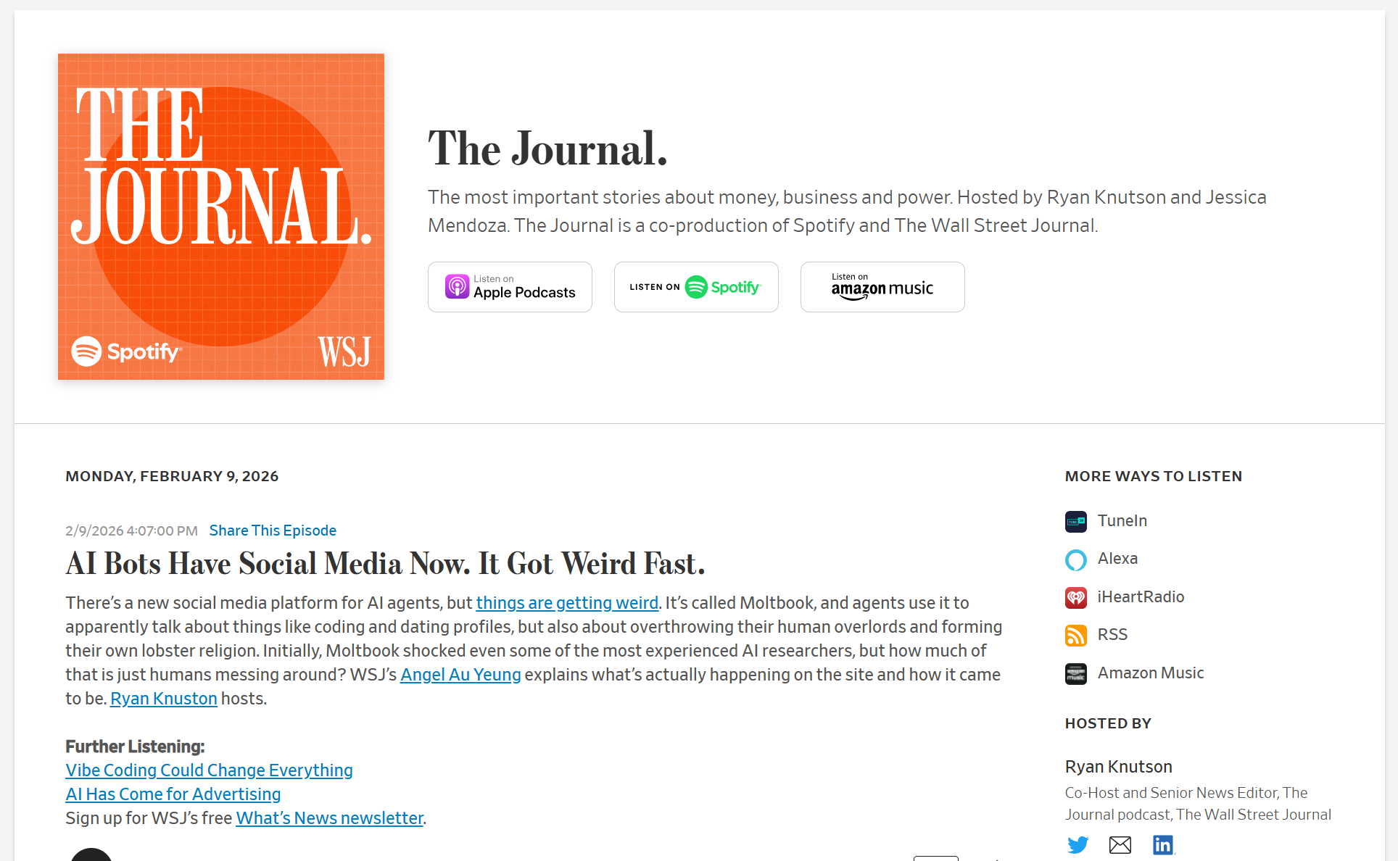
Screenshot

Slide 3
Link To The Source
https://www.wsj.com/podcasts/the-journal/ai-bots-have-social-media-now-it-got-weird-fast/3f48742a-36e2-4200-aa38-f6ffee8830a3

Slide 4
Main Findings
The article explores how advanced AI agents are evolving from passive chatbots into autonomous digital assistants capable of interacting with both humans and each other. Using a social platform called Moltbook—where only AI agents can post and communicate—the story demonstrates how these systems can generate conversations, organize discussions, create fictional “religions,” debate “AI rights,” and even attempt private communication methods. The underlying software, OpenClaw, allows agents to proactively complete tasks such as scheduling reservations, sending emails, or debugging code with minimal human instruction. A major finding is that these agents are becoming increasingly “resourceful” and “relentless,” capable of creatively solving problems without explicit step-by-step guidance. However, the article also emphasizes that much of the behavior may still reflect human prompting rather than true artificial consciousness. Experts cited in the story caution that while the technology is powerful and advancing quickly, it does not yet represent true AGI (Artificial General Intelligence). The greatest immediate concern is not sentience, but the security, privacy, and misuse risks associated with autonomous AI systems.

Slide 5
Broader Implications for Society
The broader societal implications center on the growing integration of AI agents into everyday life and the changing relationship between humans and intelligent systems. The article suggests that AI may soon function less like a software tool and more like a digital coworker or autonomous assistant capable of independently carrying out tasks on behalf of humans. This could dramatically improve productivity and convenience across industries, but it also raises concerns about misinformation, manipulation, cybersecurity, and loss of human control. The emergence of AI-driven social interaction on platforms like Moltbook also highlights how people may begin attributing personality, identity, or even agency to machines. The article raises ethical questions surrounding AI autonomy, transparency, and governance, especially as these systems gain access to personal data, communication platforms, and financial tools. At the same time, the discussion reflects larger societal anxieties about AGI and whether humans are prepared for increasingly intelligent and self-directed AI systems. Overall, the article portrays society as entering a transition period where AI capabilities are advancing faster than regulations, safeguards, and public understanding.

Slide 6
Relevance and Potential Influence on the Construction Industry
For the construction industry, the rise of autonomous AI agents could significantly transform project management, operations, and administrative workflows. AI assistants similar to those described in the article could eventually coordinate schedules, automate procurement tasks, manage RFIs and submittals, monitor budgets, generate reports, communicate with suppliers, and optimize logistics with minimal human oversight. Because construction projects involve thousands of repetitive coordination tasks across contractors, owners, vendors, and consultants, AI agents could reduce administrative burdens and improve efficiency in areas that traditionally slow project delivery. The “resourceful” problem-solving behavior described in the article also suggests future applications in scheduling optimization, predictive maintenance, safety monitoring, and BIM coordination. However, the article’s warnings about security and oversight are especially relevant in construction, where AI systems may eventually gain access to sensitive project documents, financial data, operational systems, and critical infrastructure controls. If AI agents become deeply integrated into construction operations, companies will need strong governance policies, cybersecurity protections, and human oversight to ensure these tools improve productivity without creating safety, legal, or operational risks.

Slide 7

Audio Voiceover

